Slide 1
WEB SCRAPING & DATA PROCESSING
FINAL PROJECT:
CAR PRICING PREDICTION
By Van Anh LE - Msc Computer Science - ESILV

Slide 2
TABLE OF CONTENTS
ANALYSIS
MODEL IMPROVING
01
03
BUILD MODEL
RESULT
02
04
Descriptive analysis on the dataset
Apply hyper-parameter tuning and remove noisy data to improve model’s performance
Build machine learning models to predict car price
Compare the performances and select the best model

Slide 3
PROJECT MOTIVATION
Address the evolving dynamics of the automotive market and catering to the needs of both buyers and sellers.
Provide valuable insights into the depreciation patterns, helping sellers determine fair market values for their vehicles and aiding buyers in making informed purchasing decisions.
This project aims to leverage machine learning techniques to analyze historical data, encompassing variables such as the car's make, model, mileage, year of manufacture, and additional features, to create accurate predictive models.
The goal is to empower individuals involved in the resale of used cars with tools that enhance transparency, efficiency, and fairness in the pricing process.

Slide 4
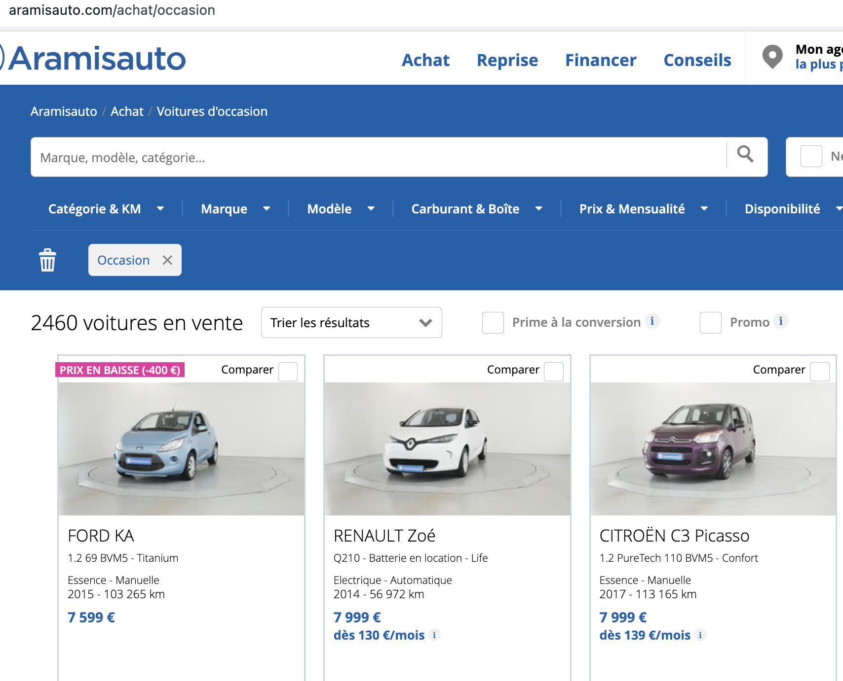
STATISTICAL DATA
DATA COLLECTION
Data is scraped from website https://www.aramisauto.com include name, brand, color, mileage, release year, fuel, gearbox, consumption, Co2 emission, price.

Slide 5
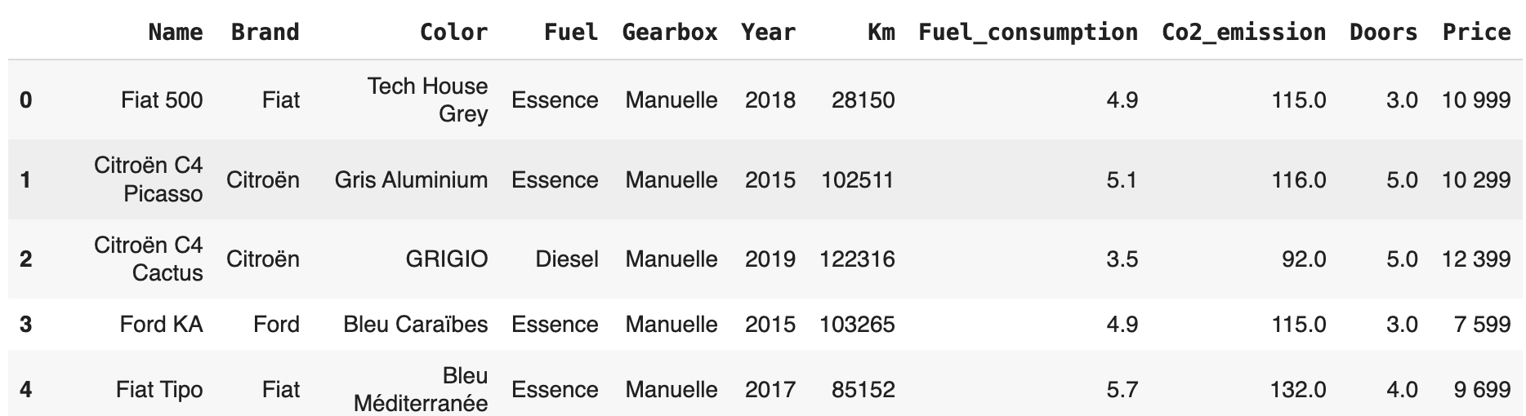
STATISTICAL DATA
The raw dataset has total 2318 samples x 11 columns

Slide 6
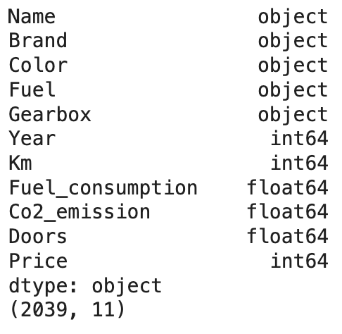
STATISTICAL DATA
TYPES OF DATA
Remove all N/A values, convert all numerical columns to correct types
After clean data, there are 2039 samples will be used to train and test the model

Slide 7
01
ANALYSIS
Descriptive analysis

Slide 8
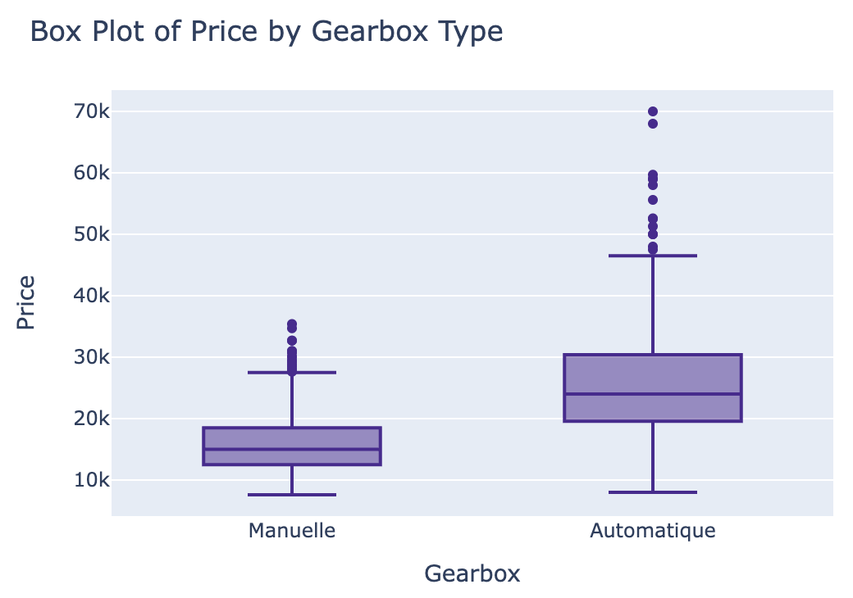
INTERPRETATION OF DATA
Average price of automatic car is higher than manual car (~ 2 times)
There are a lot of noise data (outliers). They may affect to the model’s performance.

Slide 9
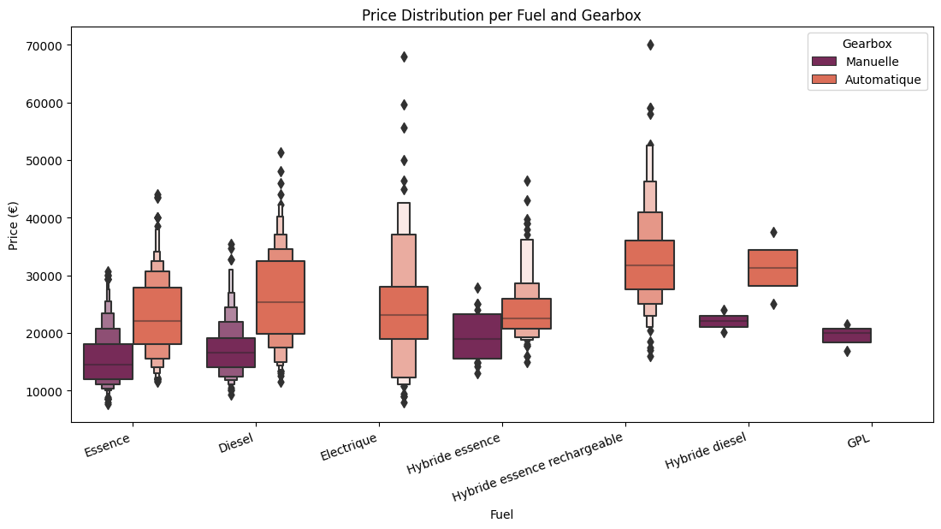
INTERPRETATION OF DATA
All the electrical and hybrid essence rechargeable cars use automatic gearbox. All GPL cars use manual gearbox.
For the automatic gearbox, hybrid essence rechargeable car has the highest average price.
For the manual gearbox, hybrid diesel has the highest price.

Slide 10
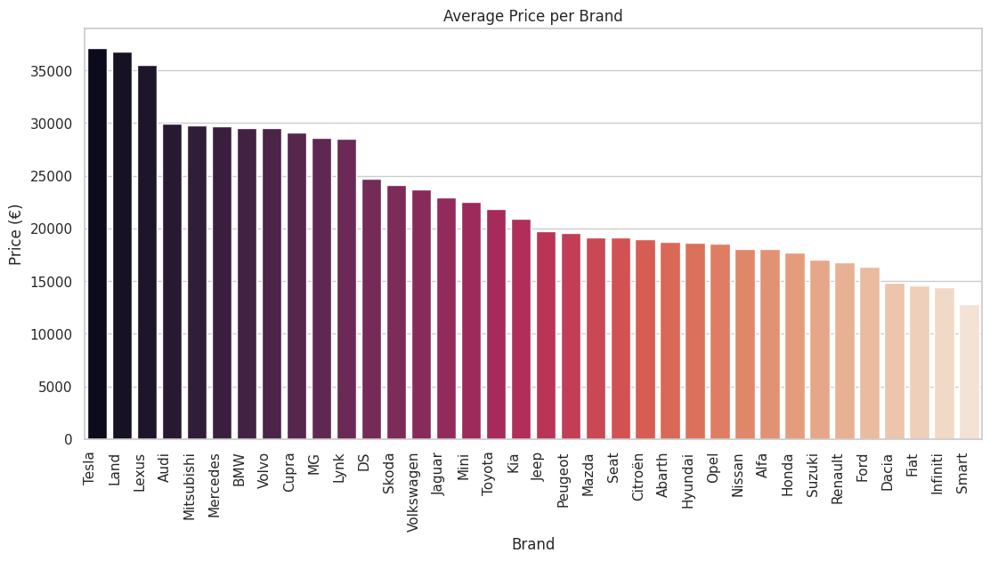
INTERPRETATION OF DATA
By brands, Tesla, Land Rover, Lexus are 3 brands that have the highest average price (>35000€)
Smart has the lowest average price (<15000€)

Slide 11
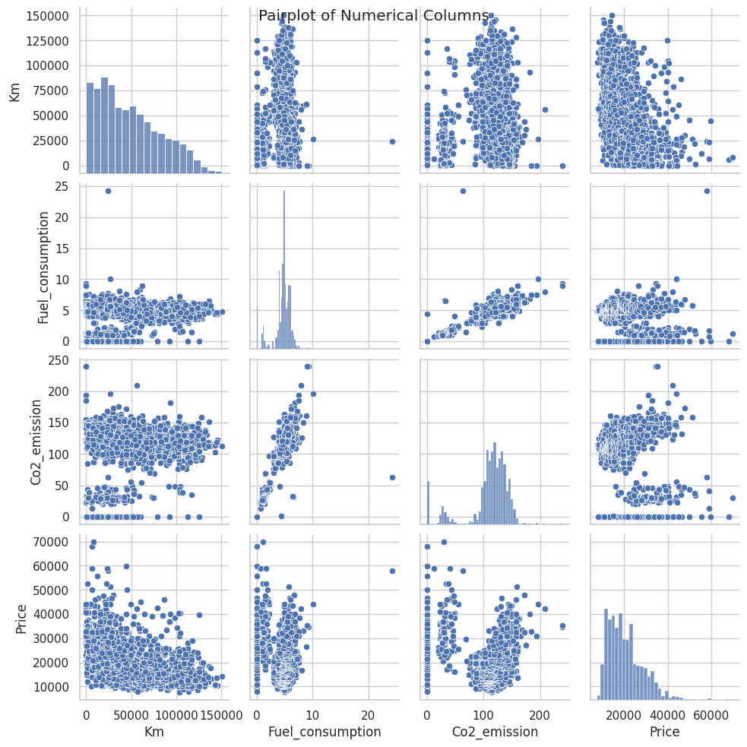
Most of the old cars are used under 50000 km, consume 4-5L of fuel/100 km, Co2 emission from 110-130g/km, with price from 8000 €- 24000€
The price and mileage have negative relation
Co2 emission and fuel consumption have positive relation

Slide 12
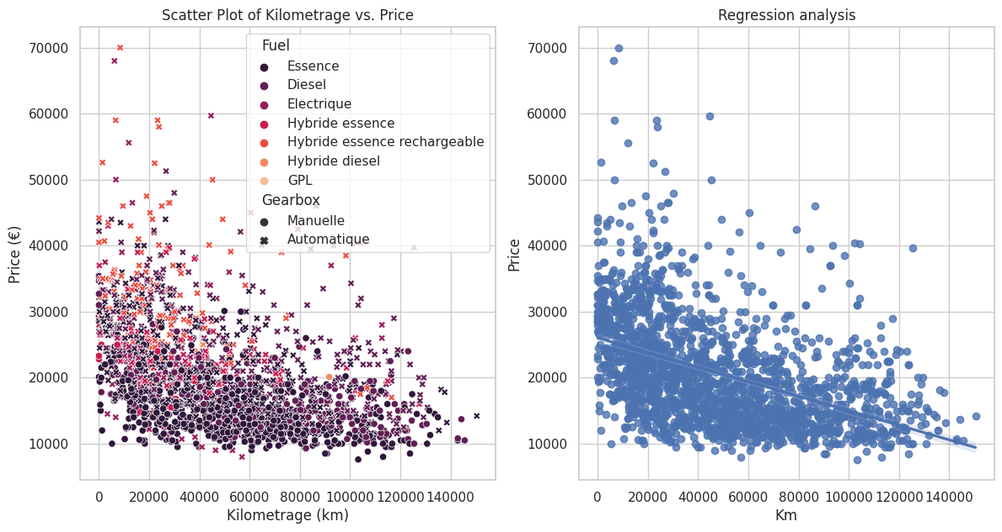
INTERPRETATION OF DATA
The higher used mileage, the lower price

Slide 13
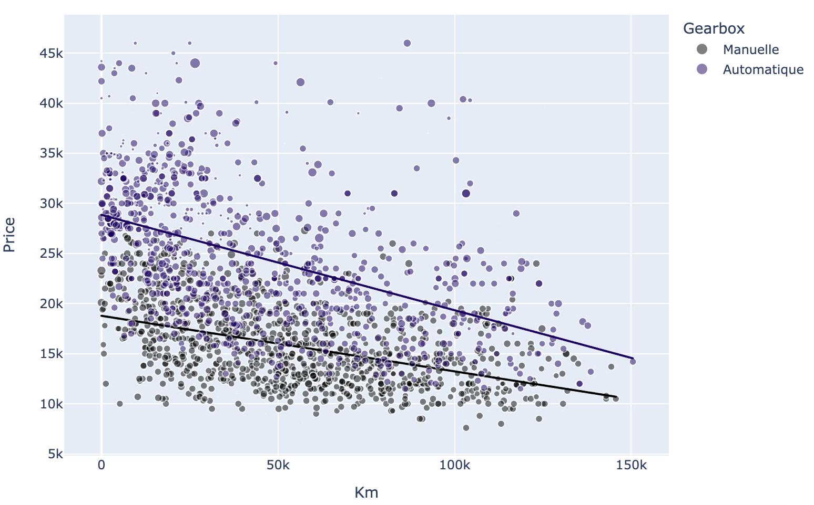
INTERPRETATION OF DATA
The linear regression of automatic cars has a higher slope than the manual cars. It means the mileage has a stronger affection to the automatic car price than to the manual car price.

Slide 14
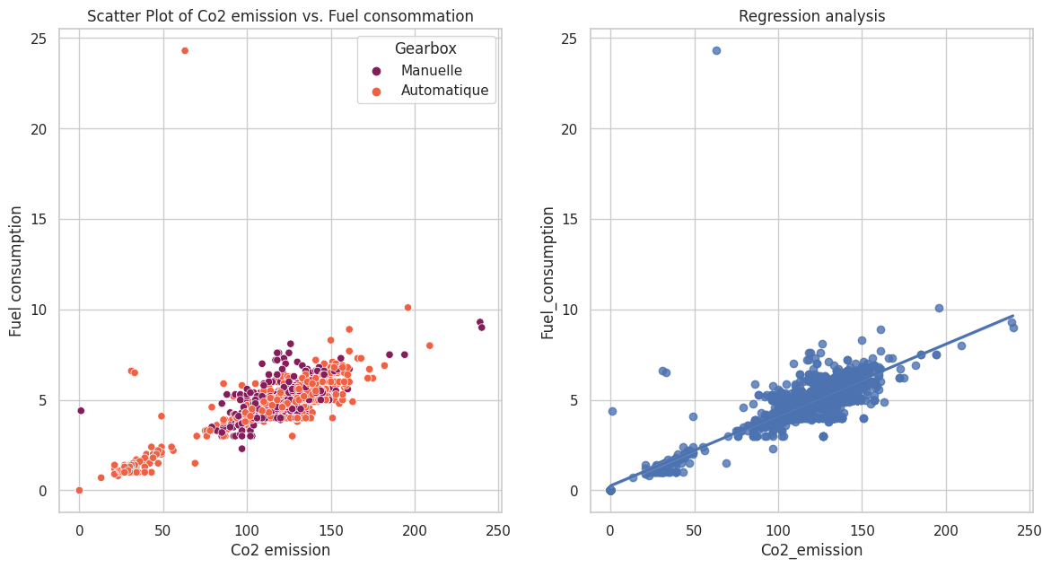
INTERPRETATION OF DATA
The higher Co2 emission, the higher fuel consumption.

Slide 15
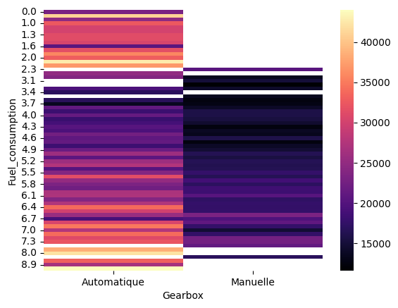
INTERPRETATION OF DATA
Heatmap of car price by fuel consumption and gearbox show that automatique car could consume less fuel than manual cars.
The automatic cars which consume fuel more than 7L/100km or less than 2.3L/100km have the highest price.

Slide 16
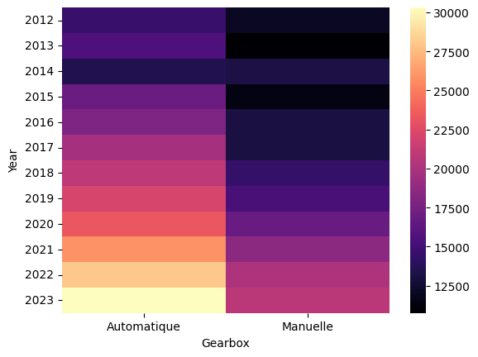
INTERPRETATION OF DATA
The newer the car is released, the higher the price

Slide 17
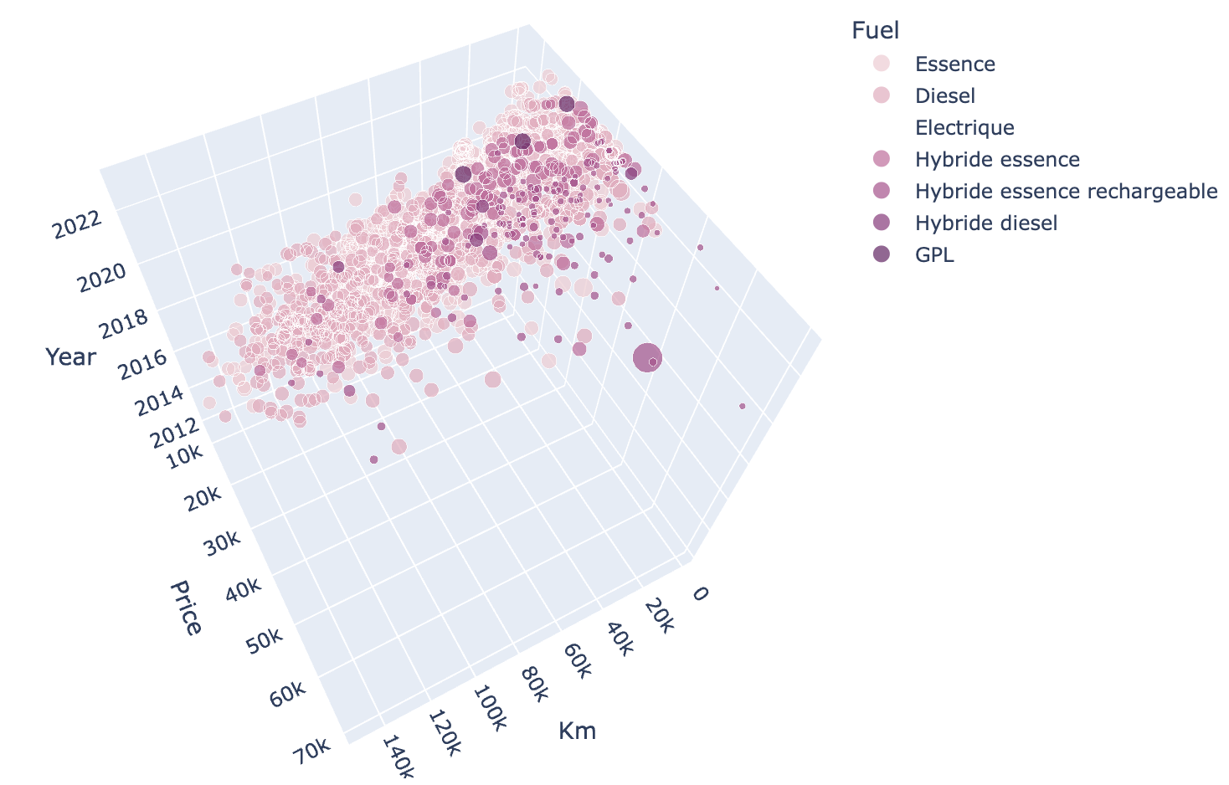
INTERPRETATION OF DATA
3D chart of distribution of milage, fuel consumption and price (click to the image to download the interactive image)

Slide 18
MODEL BUILDING
02
Build regression models to predict car price

Slide 19
PIPELINE
01
02
03
04
PLAN
SPLIT
MODELING
RESULTS
Check unique values of each feature, find the proper transform technique
Split dataset into training and testing dataset (80-20)
Create Pipeline of preprocessing and train regression models
Evaluate model’s performance

Slide 20
FEATURES ENGINEERING
One-hot Encoder
MinMax Scaler
Label Encoder
Apply on categorical features (Brand, Fuel, Gearbox)
Apply on numerical features (Year, Mileage, Fuel consumption, Co2 emission, number of door)
Apply on text features (Name, Color)

Slide 21
SUPPORTIVE TECHNIQUES
Column Transformer
Pipeline
Streamline a sequence of data processing steps.
Define and execute a sequence of transformations and train model in a sequential manner.
Apply different preprocessing steps to different subsets of features in your dataset.
Apply scaling to numerical features and one-hot encoding to categorical features simultaneously

Slide 22
ARCHITECTURES
XGB
LINEAR
LASSO
RIDGE
RANDOM FOREST
SVR
ENSEMBLE

Slide 23
MODEL EVALUATION CRITERIAS
Root Mean Squared Error
Mean Absolute Error
R-squared
Adjusted R-squared
Measure the average magnitude of the errors between predicted and actual values in a set of data. A lower RMSE indicates better model performance
Measure the average absolute differences between predicted and actual values in a set of data, A lower MAE indicates better model performance
Coefficient of determination, evaluate the goodness of fit of the model. R-squared is a value between 0 and 1, where 1 indicates that the model explains all the variability in the dependent variable
A modified version of the R-squared statistic that adjusts for the number of predictors in a regression model

Slide 24
03
MODEL IMPROVING
Apply techniques to improve model’s performance

Slide 25
IMPROVING METHODS
Before improving, all the models have low R2 and adjusted R2 (~ 76-80%)
HYPERPARAMETER TUNING | REMOVE NOISE DATA
Use GridSearchCV to find the best parameters for each model | Remove automatic cars with price higher than €46499, and manuelle cars with price higher than €27499 (Total remove 14%)

Slide 26
AFTER HYPER-TUNING
Model | Root Mean Squared Error | Mean Absolute Error | R-squared | Adjusted R-squared
XGB Regression | 3730.39 | 2234.46 | 0.8091 | 81.403272
Linear Regression | 3791.78 | 2597.14 | 0.8027 | 80.759321
Lasso Regression | 3793.64 | 2587.4 | 0.8025 | 80.739198
Ridge Regression | 3843.03 | 2625.53 | 0.7974 | 80.226049
Random Forest Regression | 3516.62 | 2024.4 | 0.8303 | 83.536358
Ensemble Regression | 3356.86 | 2046.02 | 0.8454 | 85.055679

Slide 27
AFTER REMOVE NOISE DATA
Model | Root Mean Squared Error | Mean Absolute Error | R2 | Adjusted R2 | Training time (s)
XGB Regression | 2639.97 | 1861.12 | 0.8699 | 87.531158 | 1.96
Linear Regression | 3153.39 | 2366.13 | 0.8143 | 81.936167 | 0.22
Lasso Regression | 3147.77 | 2361.41 | 0.8150 | 82.006608 | 1.12
Ridge Regression | 3179.73 | 2389.85 | 0.8112 | 81.624216 | 0.15
Random Forest Regression | 2798.75 | 1873.75 | 0.8538 | 85.911026 | 8.88
SVR Regression | 3108.93 | 2331.33 | 0.8195 | 82.459440 | 3.50
Ensemble Regression | 2562.30 | 1769.78 | 0.8774 | 88.285878 | 9.14

Slide 28
RESULTS
04
Select the best models

Slide 29
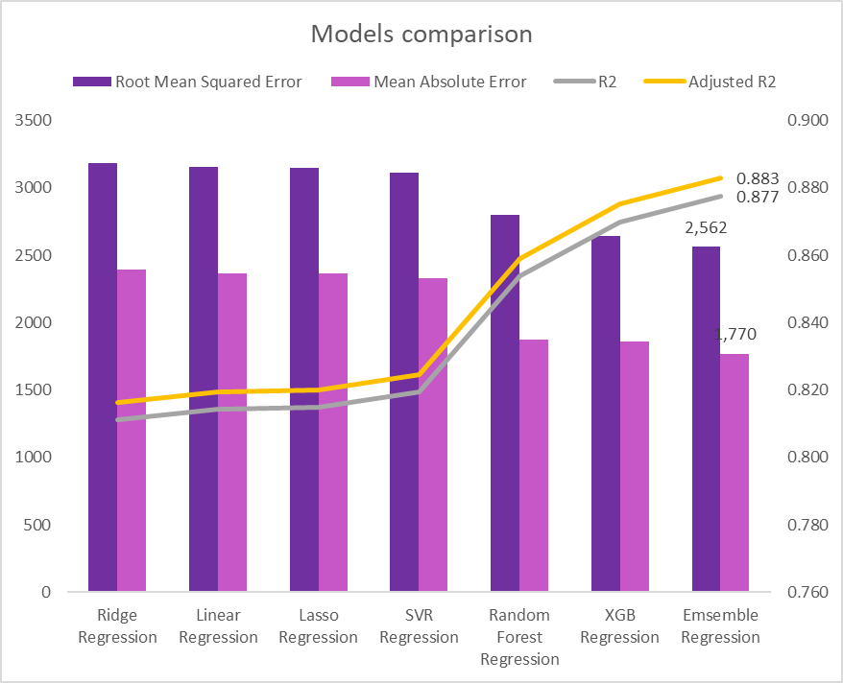

Slide 30
CONCLUSION
We can use some variables to predict old car price: Car name, brand, color, fuel, gearbox, mileage, fuel consumption, Co2 emission, release year, number of door
Ensemble Learning Model is the best model to predict car price with the highest R-squared & adjusted R-squared value (88.29%), smallest RMSE and MAE, quick training time (9.14s)

Slide 31
THANK YOU

